Slide 1
Activation Functions
Abhijit Ramesh Patil

Slide 2
What is Activation Function ?
Activation function is also known as Transfer function. It can be attached in between 2 neural networks.
It is important for ANN to learn and understand the complex patterns.
The main function of it is to introduce non linear properties into the network.
It calculates the ‘Weighted sum’ and adds direction and decides whether to ‘fire’ a particular neuron or not.
Their main purpose is to convert a input signal of a node in a ANN to an output signal. That output signal is used as input in the next layer.

Slide 3
What if we don’t use activation function in our model ?
If we don’t apply activation function then the output signal would simply be a simple linear function.
Linear equation is easy to solve but they are limited in their complexity and has less power to learn complex functional mappings from data.
A neural network without activation function would simply be a Linear Regression Model, which has limited power and does not perform good most of the times.
Without activation function our model would not be able to learn complicated data such as images, videos, audio, speech etc.

Slide 4
Types of activation functions
Activation functions are mainly divided into 2 types
1) Linear activation function
2) Non-Linear activation function

Slide 5
Linear or Identity function
As the function is line or linear therefore the output of the function will not be confined between any range.
Equation :
f(x) = x
Range : (-infinity to +infinity)
It does not help with the complexity of data fed to the neural network.

Slide 6
Step function
Step function is one of simplest kind of activation function.
In this we consider threshold value and if the value of net input (y) is greater than threshold then neuron is activated.
Equation :
f(x) = 1 , if x >= 0

Slide 7
Why do we need non Linearities ?
Non linear function are those which have degree more than one and they have curvature when we plot Non Linear function.
Now we need a Neural Network Model to learn and represent almost anything and any arbitrary complex function which maps inputs and outputs.
Using Non Linear Activation function we are able to generate non linear mappings from inputs to outputs.
It makes easy to generalise model and adapt with variety of data and to differentiate between the output.

Slide 8
Sigmoid or Logistic Activation Function
Sigmoid function curve look like S shape.
The main reason to use Sigmoid function is it exist between (0 to 1).
It is used especially for models where we have to predict probability as an output.
The beauty of exponent is that the value never reaches zero nor exceeds 1. The large negative number are scaled towards 0 and large positive numbers are scaled towards 1.

Slide 9
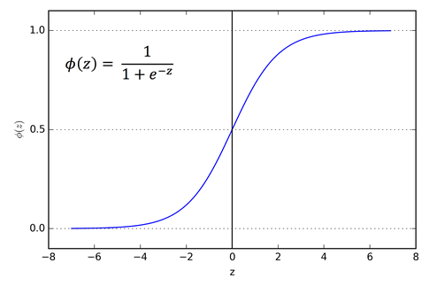
Sigmoid Function

Slide 10
Disadvantages of Sigmoid activation function
Sigmoid saturates and kills gradients
Sigmoid have slow convergence
Vanishing gradient problem
Out is not zero centred
It makes gradient updates go too far in different directions. 0 < output < 1, it makes optimization harder.

Slide 11
Hyperbolic tangent function - tanh
Its mathematical formula is
Its output is zero centred because its range in between -1 to 1 that is -1 < output < 1.
Optimization is easier in this method and hence is always preferred over sigmoid function.
But still suffer from vanishing gradient problem.

Slide 12
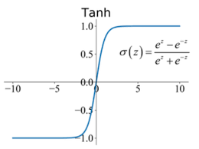
tanh Function

Slide 13
ReLU – Rectifier Linear Unit
ReLU function is given by
R(x) = max(0,x) that is if x < 0, R(x) = 0 and
if x >= 0, R(x) = x.
Hence it avoids and rectifies vanishing gradient problem.
It was recently proved that it had 6 times improvement in convergence from tanh functions.
Its limitation is it is used in the hidden layers only.
Another problem with ReLU is some gradient can be fragile during training and can die. It can cause a weight update which will makes it never activate in any data point again.

Slide 14
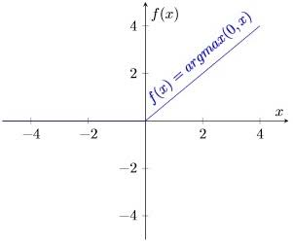
ReLU function

Slide 15
Leaky ReLU
It is improved version of ReLU function.
Instead of ReLU function defining as zero for x less than zero, we define as small linear component of x.
It can be defined as
f(x) = ax, x < 0
else f(x) = x
It introduces small slope to keep the updates alive.

Slide 16
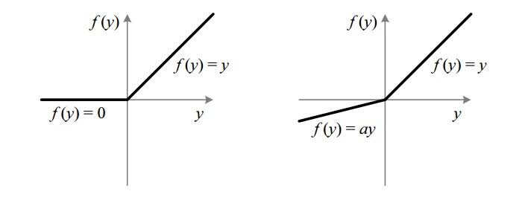
ReLU function
ReLU function

